Slide 1
Predicting the Spread of a Disease- Zika Virus
Machine Learning Final Project Presentation
Presented by: GPS-V
Gulnara Timokhina, Poornapragna Vadiraj, Mirsaeid Abolghasemi, Varun Bhaseen

Slide 2
Project Purpose and Objectives
Determine various conditions required for Zika to occur
Identify the additional parameters not defined in base dataset which contribute to outbreak
Tuning of models to refine the accuracy attained by the models and publish the results
Amalgamate the additional features in primary dataset which influence disease occurrence
Visualize the impact of each parameter on Occurrence of Zika
Compare various ML models which can predict the occurrence of Zika based on training
Predicting the probability of Zika occurrence in any region

Slide 3
Step-1: Gathering Data
Step-3: Data preprocessing
Step-4: Feature Engineering
Step-6: Amalgamation of 2 Dataset
Step-7: Modelling and Tuning
Step-2: Exploratory data analysis
Step-5: Identification of latent variables
Step-8: Deployment of Model
KDD Methodology and Approach

Slide 4
Modelling infectious diseases in Humans and Animals
For link click here.
Basic reproduction number and how to use it
For link click here.
Zika: Characteristics of patients [CDC article]
For link click here.
Sensitivity of RT-PCR method in samples shown to be positive for Zika virus
For link click here.
Zika virus introduction and emergence [Book]
Zika Virus: A Global Public Health Menace: A Comprehensive Update
For link click here.
For link click here.
Research Paper
Since we don’t have domain expertise on virology, so we went through multiple research papers to identify various factors which can determine and contribute to the spread of Zika Virus among a community.
The references of those are given beside

Slide 5



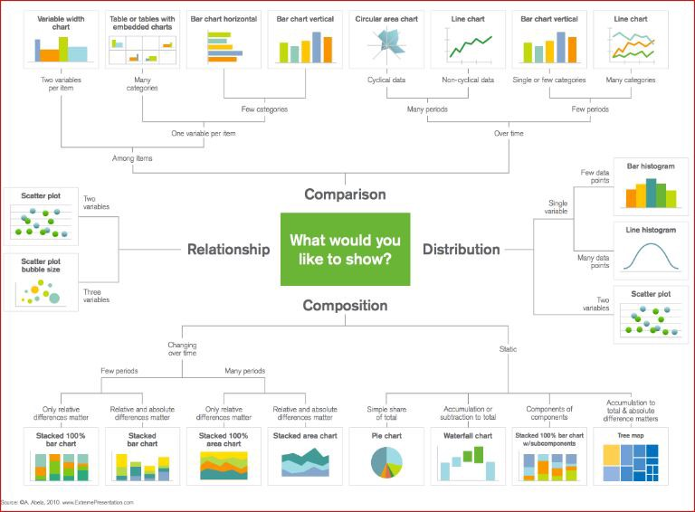




Project Flow
1. Data Source
2. Research and collaboration on Topic
3. API Identification and website for scrapping
4. Data Cleaning
5. Data Preprocessing
6. Data Amalgamation
7. Data Visualization
8. ML Modelling and Tuning
9. Comparison and Publishing Result
All images belongs to respective owners. No copyright intended. The images were purely used for academic purpose for explaining the various stages of project. In case of Objection reach out to us so we can remove

Slide 6
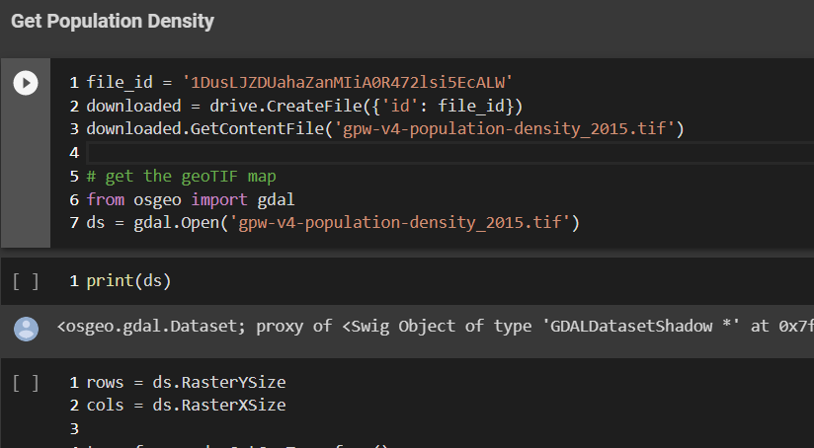
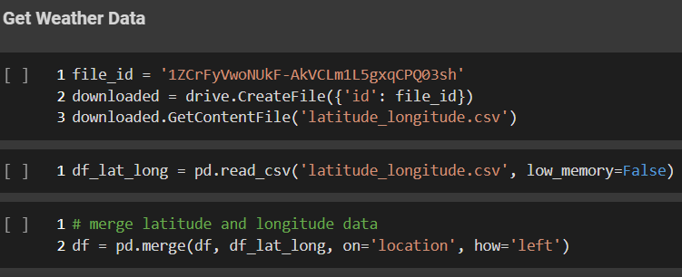
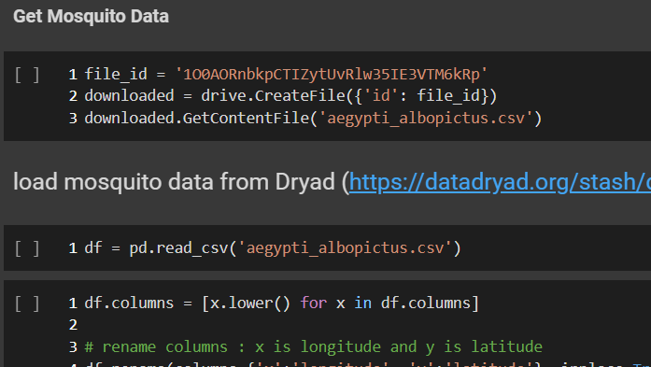
Data Sources
Base Dataset
Latitude and Longitude dataset
Population Density Dataset
Weather Dataset
Mosquito Data
Kaggle link
Api link
Api link
Api link
Api link
Screen Shot from Colab file

Slide 7
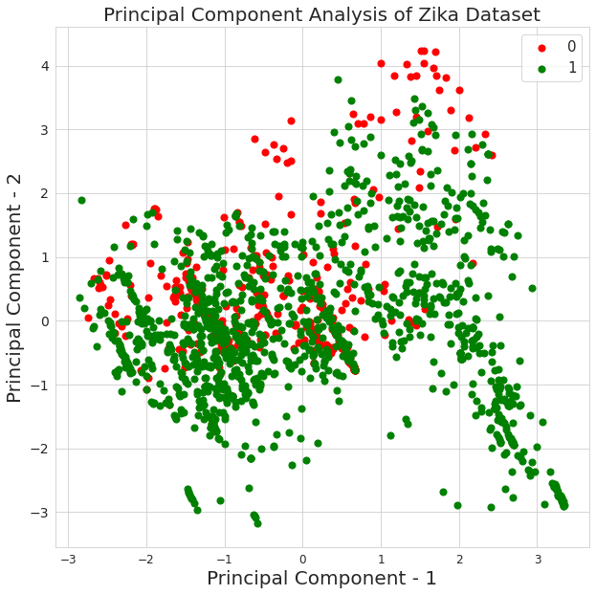
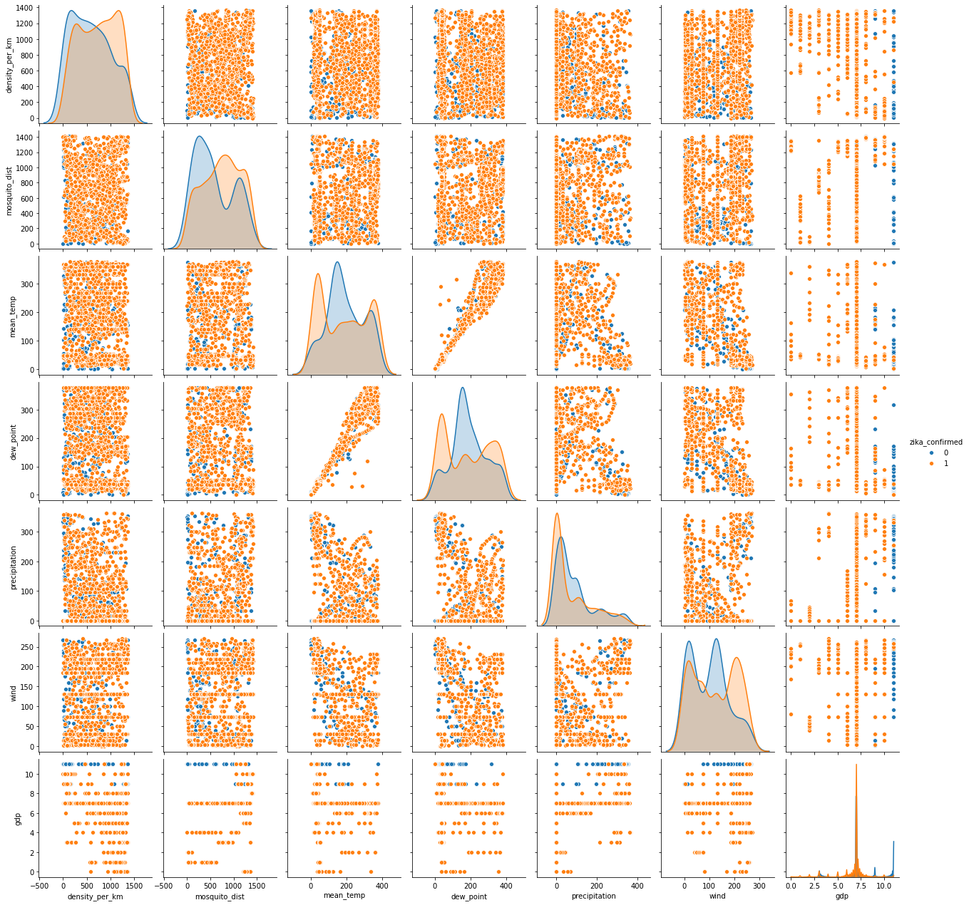

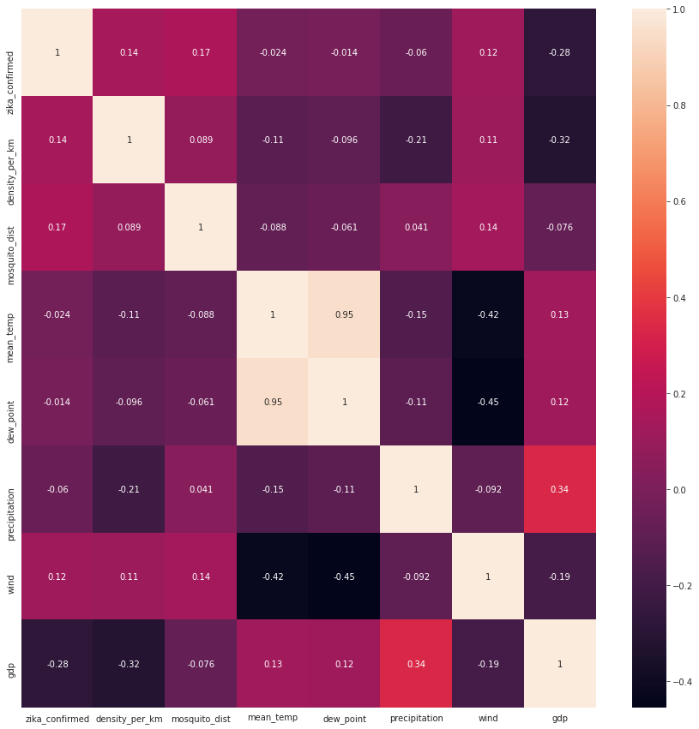
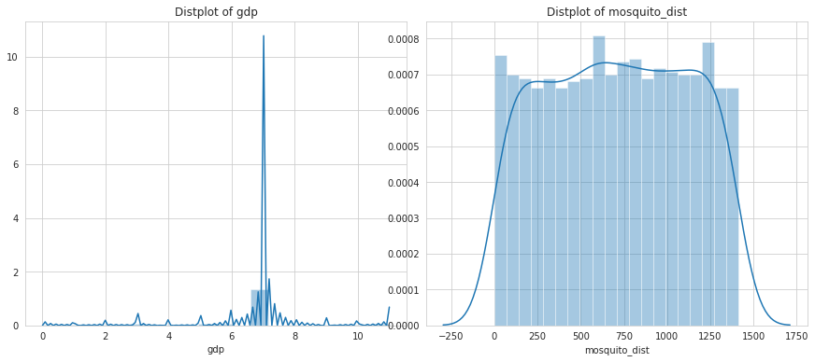
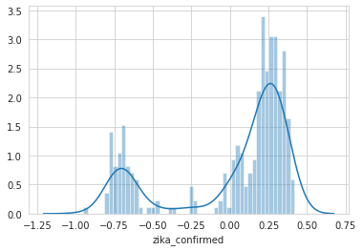
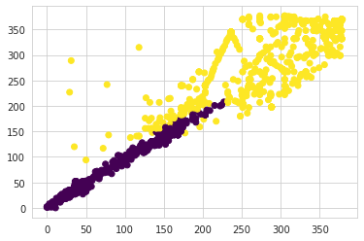
Examples of Visualizations Used

Slide 8
Dimensionality & Data Reduction
PCA
Clustering
Dimensionality reduction
(Dropping latitude, longitude, min-max temp etc.)
GMM and K-means: Data grouping Location and weather parameters
Fractal: Noise and outlier removal
Combining multiple weather parameters into 2 Principal Components

Slide 9
Data Cleaning and Preparation activities
Temperature and weather features:
Since we carried out amalgamation of weather data from two sources, the challenge was that some of the data was in Celsius and some in Fahrenheit.
Distance features:
Just like temperature data even distance was in some places measured in empirical units and in some places in standard units. Fixed distance values
The country and province was a common column in our primary dataset while it was two separate features in weather and mosquito datasets. Fixing country names
Country and Province bifurcation:
Removing Noise:
Fractal clustering was carried out to remove noise and outliers from the dataset

Slide 10
Project is divided into two parts:
ML Model application, Visualization and Tuning
Exploratory Data Analysis, Preprocessing and Amalgamation

Slide 11
Performance Evaluation of different Model

Slide 12
Conclusion
Project Application and Usage

Slide 13
Gulnara Timokhina
Poornapragna Vadiraj
Mirsaeid Abolghasemi
San Jose State University
San Jose, USA
Gulnara.timokhina@sjsu.edu
Software Engineering Department
Software Engineering Department
San Jose State University
San Jose, USA
poornapragna.vadiraj@sjsu.edu
Software Engineering Department
San Jose State University
San Jose, USA
mirsaeid.abolghasemi@sjsu.edu
Varun Bhaseen
Software Engineering Department
San Jose State University
San Jose, USA
varun.bhaseen@sjsu.edu
Teamwork
Activities for the Project
Extract Data for Training Set | API identification Data Collection Format data as necessary
Data Preparation and Preprocessing | Select the Data required Cleanse the Data Label the data Identify Features
Data Modelling | Identify target Output Select Algorithms Make predictive models
Train the Model | Run Algorithm on Labelled data Verify the output
Evaluate the Model | Plot the outputs Test the unlabeled data
Iterate and Fine-tune the Model | Identify additional features and assign weights Validate the results and Iterate for fine-tuning the algorithms
Verify and Pilot | Verify Final Model Prepare Visualization Prepare Outputs

Slide 14
Thank You

